Slide 1
Cost-Sensitive Feature Value Acquisition in Testing
Victor Sheng
Computer Science
Texas Tech University
victor.sheng@ttu.edu

Slide 2
Everything has a cost/benefit!
Materials, products, services, waiting…
In medical diagnosis…
  Tests have costs: temperature ($1), X-ray ($30)
  Misdiagnoses have (different) costs
    Cost of false alarm ($500) << cost of missing a cancer ($500,000)
  Doctors: balance the cost of tests and misdiagnosis
  The goal: to minimize the total cost
Model this process
  Cost-sensitive learning
  Feature value acquisition
Patient | Test 1 | Test 2 | … | Test n | Cancer?
(Cost) | $10 | $30 | ... | $900 | FP/FN= 500/500k
001 | 39 | Low | … | High | 1
002 | 35 | Med | … | ? | 0
003 | 42 | ? | … | ? | 0
… | … | … | … | … | …
New1 | ? | ? | … | ? | ?

Slide 3
Outline
Introduction
Cost-sensitive decision tree
Feature value acquisition
Conclusions and future extensions

Slide 4
Cost-Sensitive Decision Tree (CSTree)
T2
Patient | Test 1 | Test 2 | … | Test n | Cancer?
(Cost) | $1 | $30 | ... | $900 | FP/FN= 100/300k
001 | 39 | Low | … | High | 1
002 | 35 | Med | … | ? | 0
003 | 42 | ? | … | ? | 0
… | … | … | … | … | …
Low
Med
T3
T1
1
2
<36
>=36
0
1
0
T6
a
b
c
0
1
0
Objective: minimizing the total cost of tests and misclassification.
Advantages: tree structure, comprehensibility

Slide 5
Attribute Splitting Criteria (I)
Previous methods: C4.5 reduces the entropy (randomness), performs badly on cost sensitive tasks
CSTree reduces the total cost
T/E
1
2
3
E1
E2
E3
Choose T such that
E – (E1+E2+E3) is max
T/C
1
2
3
C1
C2
C3
Choose T such that
C – (C1+C2+C3+C_Test) is max

Slide 6
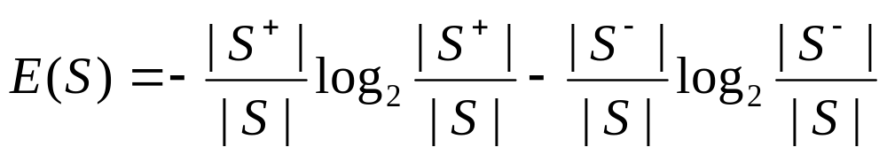
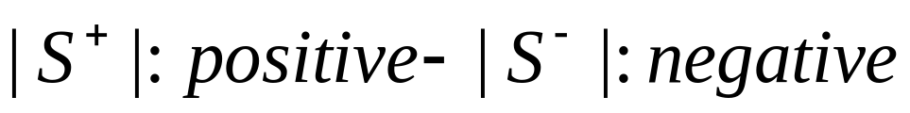
Entropy
Entropy:
E({+,+,+,+,+,+})=0
E({+,-, +,-, +,- })=1

Slide 7
Details 1
P:N
A set of Data
Labeling a set according to minimal misclassification cost
Cost matrix
If Positive, Cost = P×TP+ N×FP
If Negative, Cost = N×TN+ P×FN
Total cost before splitting:
C = min(P×TP+ N×FP, N×TN+ P×FN)
 |  | True Class
 |  | Positive | Negative
PredictClass | Positive | TP | FP
 | Negative | FN | TN

Slide 8
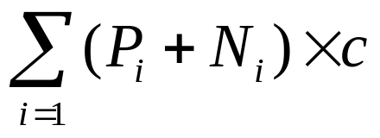
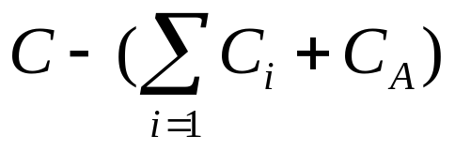
Details 2
P:N
A set of Data
1
2
3
Attribute: A
P1:N1
P2:N2
P3:N3
3 subsets
If attribute/test A is chosen to split…
C_{i} = min (P_{i}×TP+ N_{i}×FP, N_{i}×TN+ P_{i}×FN)
C_{A} =
Cost reduction:
Choose an attribute with max cost reduction

Slide 9
Case Study: Heart Disease
Predict coronary artery disease
Class 1: ≥ 50% artery narrowing;
Class 0: < 50% artery narrowing;
~300 patients, collected from hospitals
13 non-invasive tests on patients

Slide 10
13 Tests (Heart Disease) FP/FN=600/1000
Tests | Description | Costs | Delay (hrs)
age | age of the patient | 1.00 | 0.001
sex | sex | 1.00 | 0.001
cp | chest pain type | 1.00 | 0.001
trestbps | resting blood pressure | 1.00 | 0.01
chol | serum cholesterol in mg/dl | 7.27 | 4
fbs | fasting blood sugar | 5.20 | 4
restecg | resting electrocardiography test | 15.50 | 0.5
thalach | maximum heart rate achieved | 102.90 | 1
thal | finishing heart rate | 102.90 | 1
exang | exercise induced angina | 87.30 | 1
oldpeak | ST depression induced by exercise | 87.30 | 1
slope | slope of the peak exercise ST segment | 87.30 | 1
ca | number of major vessels colored | 100.90 | 1

Slide 11
CSTree with hourly rate ($1/hr) for Heart Disease
cp
($1/0.001)
Delay cost = delay time * hourly rate
1
2
3
4
sex
($1/0.001)
trestbps
($1/0.01)
age
($1/0.001)
slope
($87.3/1)
Naturally prefer tests with small cost
Balance cost and discriminating power
1
2
1
2
1
2
1
2
3
0
trestbps
($1/0.01)
0
exang
($87.3/1)
trestbps
($1/0.01)
slope
($87.3/1)
0
sex
($1/0.001)
1
1
2
1
2
1
2
1
2
1
2
0
1
0
oldpeak
($87.3/1)
0
sex
($1/0.001)
0
1
age
($1/0.001)
fbs
($5.2/4)
1
2
2
1
2
1
2
1
0
sex
($1/0.001)
0
exang
($87.3/1)
1
fbs
($5.2/4)
0
1
1
2
1
2
1
2
0
1
0
1
0
1

Slide 12
CSTree with hourly rate ($100/hr) for Heart Disease
cp
($1/0.1)
Delay cost = delay time * hourly rate
4
1
2
3
sex
($1/0.1)
sex
($1/0.1)
trestbps
($1/1)
age
($1/0.1)
Naturally prefer tests with small cost
Balance cost and discriminating power
1
2
1
2
1
2
1
2
0
trestbps
($1/1)
0
age
($1/0.1)
trestbps
($1/1)
trestbps
($1/1)
0
1
1
2
1
2
1
2
1
2
0
1
sex
($1/0.1)
sex
($1/0.1)
0
sex
($1/0.1)
sex
($1/0.1)
slope
($87.3/100)
1
2
1
2
1
2
1
2
1
2
0
1
0
slope
($87.3/100)
0
exang
($87.3/100)
0
restecg
($15.5/50)
0
1
1
2
1
2
1
2
3
0
1
0
1
0
1
0

Slide 13
Comparison between the two Cost-sensitive trees
Delay cost can affect the tree significantly
Naturally prefer tests with small sum of test cost and delay cost.
Balance cost and discriminating power
cp
($1/0.001)
cp
($1/0.1)
4
1
2
3
4
1
2
3
sex
($1/0.1)
sex
($1/0.001)
trestbps
($1/0.01)
age
($1/0.001)
slope
($87.3/1)
sex
($1/0.1)
trestbps
($1/1)
age
($1/0.1)
1
2
1
2
1
2
1
2
3
1
2
1
2
1
2
1
2
0
trestbps
($1/0.01)
0
exang
($87.3/1)
trestbps
($1/0.01)
slope
($87.3/1)
0
sex
($1/0.001)
1
0
trestbps
($1/1)
0
age
($1/0.1)
trestbps
($1/1)
trestbps
($1/1)
0
1
1
2
1
2
1
2
1
2
1
2
1
2
1
2
1
2
1
2
0
1
0
oldpeak
($87.3/1)
0
sex
($1/0.001)
0
1
age
($1/0.001)
fbs
($5.2/4)
0
1
sex
($1/0.1)
sex
($1/0.1)
0
sex
($1/0.1)
sex
($1/0.1)
slope
($87.3/100)
1
2
1
2
1
2
1
2
1
2
2
1
2
1
2
sex
($1/0.001)
1
0
0
exang
($87.3/1)
1
fbs
($5.2/4)
0
1
0
slope
($87.3/100)
0
exang
($87.3/100)
0
restecg
($15.5/50)
0
1
1
2
1
2
1
2
1
2
1
2
1
2
3
0
1
0
1
0
1
0
1
0
1
0
1
0

Slide 14
Outline
Introduction
Cost-sensitive decision tree
Feature value acquisition
Conclusions and future extensions

Slide 15
Case Study: Heart disease (II)
 | age | sex | cp | restecg | trestbps | slope | chol | … | class
patient | ? | ? | ? | ? | ? | ? | ? | … | ?
 | … | restecg | trestbps | slope | chol | … | class (FP/FN)
Cost ($) | … | 15.5 | 1.0 | 87.3 | 7.27 | … | 600/1000
Delay time (hr) | … | 0.5 | 0.01 | 1 | 4 | …
slope
slope, chol
Total cost: misclassification + attribute (tests) + waiting
Sequential Test
chol
restecg
Single Batch Test
Multiple Batch Test
slope, chol, restecg, …
…
…
Classify
Classify
Classify

Slide 16
Sequential Test
Use tree structure to guide test sequence

Slide 17
Sequential Test
cp
($1/0.001)
1
2
3
4
sex
($1/0.001)
trestbps
($1/0.01)
age
($1/0.001)
slope
($87.3/1)
1
2
1
2
1
2
1
2
3
0
trestbps
($1/0.01)
0
exang
($87.3/1)
trestbps
($1/0.01)
slope
($87.3/1)
0
sex
($1/0.001)
1
1
2
1
2
1
2
1
2
1
2
0
1
0
oldpeak
($87.3/1)
0
sex
($1/0.001)
0
1
age
($1/0.001)
fbs
($5.2/4)
1
2
2
1
2
1
2
1
0
sex
($1/0.001)
0
exang
($87.3/1)
1
fbs
($5.2/4)
0
1
1
2
1
2
1
2
0
1
0
1
0
1

Slide 18
Sequential Test
cp
($1/0.001)
1
2
3
4
cp is unknown.
sex
($1/0.001)
trestbps
($1/0.01)
age
($1/0.001)
slope
($87.3/1)
1
2
1
2
1
2
1
2
3
0
trestbps
($1/0.01)
0
exang
($87.3/1)
trestbps
($1/0.01)
slope
($87.3/1)
0
sex
($1/0.001)
1
1
2
1
2
1
2
1
2
1
2
0
1
0
oldpeak
($87.3/1)
0
sex
($1/0.001)
0
1
age
($1/0.001)
fbs
($5.2/4)
1
2
2
1
2
1
2
1
0
sex
($1/0.001)
0
exang
($87.3/1)
1
fbs
($5.2/4)
0
1
1
2
1
2
1
2
0
1
0
1
0
1

Slide 19
Sequential Test
cp
($1/0.001)
1
2
3
4
sex
($1/0.001)
trestbps
($1/0.01)
age
($1/0.001)
slope
($87.3/1)
1
2
1
2
1
2
1
2
3
0
trestbps
($1/0.01)
0
exang
($87.3/1)
trestbps
($1/0.01)
slope
($87.3/1)
0
sex
($1/0.001)
1
1
2
1
2
1
2
1
2
1
2
0
1
0
oldpeak
($87.3/1)
0
sex
($1/0.001)
0
1
age
($1/0.001)
fbs
($5.2/4)
1
2
2
1
2
1
2
1
0
sex
($1/0.001)
0
exang
($87.3/1)
1
fbs
($5.2/4)
0
1
1
2
1
2
1
2
0
1
0
1
0
1

Slide 20
Sequential Test
cp
($1/0.001)
1
2
3
4
sex
($1/0.001)
trestbps
($1/0.01)
age
($1/0.001)
slope
($87.3/1)
1
2
1
2
1
2
1
2
3
0
trestbps
($1/0.01)
0
exang
($87.3/1)
trestbps
($1/0.01)
slope
($87.3/1)
0
sex
($1/0.001)
1
1
2
1
2
1
2
1
2
1
2
0
1
0
oldpeak
($87.3/1)
0
sex
($1/0.001)
0
1
age
($1/0.001)
fbs
($5.2/4)
1
2
2
1
2
1
2
1
0
sex
($1/0.001)
0
exang
($87.3/1)
1
fbs
($5.2/4)
0
1
1
2
1
2
1
2
0
1
0
1
0
1

Slide 21
Sequential Test
cp
($1/0.001)
1
2
3
4
sex
($1/0.001)
trestbps
($1/0.01)
age
($1/0.001)
slope
($87.3/1)
1
2
1
2
1
2
1
2
3
0
trestbps
($1/0.01)
0
exang
($87.3/1)
trestbps
($1/0.01)
slope
($87.3/1)
0
sex
($1/0.001)
1
1
2
1
2
1
2
1
2
1
2
0
1
0
oldpeak
($87.3/1)
0
sex
($1/0.001)
0
1
age
($1/0.001)
fbs
($5.2/4)
1
2
2
1
2
1
2
1
0
sex
($1/0.001)
0
exang
($87.3/1)
1
fbs
($5.2/4)
0
1
1
2
1
2
1
2
0
1
0
1
0
1

Slide 22
Sequential Test
cp
($1/0.001)
1
2
3
4
sex
($1/0.001)
trestbps
($1/0.01)
age
($1/0.001)
slope
($87.3/1)
1
2
1
2
1
2
1
2
3
0
trestbps
($1/0.01)
0
exang
($87.3/1)
trestbps
($1/0.01)
slope
($87.3/1)
0
sex
($1/0.001)
1
1
2
1
2
1
2
1
2
1
2
0
1
0
oldpeak
($87.3/1)
0
sex
($1/0.001)
0
1
age
($1/0.001)
fbs
($5.2/4)
1
2
2
1
2
1
2
1
0
sex
($1/0.001)
0
exang
($87.3/1)
1
fbs
($5.2/4)
0
1
1
2
1
2
1
2
0
1
0
1
0
1

Slide 23
Sequential Test
cp
($1/0.001)
1
2
3
4
sex
($1/0.001)
trestbps
($1/0.01)
age
($1/0.001)
slope
($87.3/1)
1
2
1
2
1
2
1
2
3
0
trestbps
($1/0.01)
0
exang
($87.3/1)
trestbps
($1/0.01)
slope
($87.3/1)
0
sex
($1/0.001)
1
1
2
1
2
1
2
1
2
1
2
0
1
0
oldpeak
($87.3/1)
0
sex
($1/0.001)
0
1
age
($1/0.001)
fbs
($5.2/4)
1
2
2
1
2
1
2
1
0
sex
($1/0.001)
0
exang
($87.3/1)
1
fbs
($5.2/4)
0
1
1
2
1
2
1
2
0
1
0
1
0
1

Slide 24
Sequential Test
cp
($1/0.001)
1
2
3
4
sex
($1/0.001)
trestbps
($1/0.01)
age
($1/0.001)
slope
($87.3/1)
1
2
1
2
1
2
1
2
3
0
trestbps
($1/0.01)
0
exang
($87.3/1)
trestbps
($1/0.01)
slope
($87.3/1)
0
sex
($1/0.001)
1
1
2
1
2
1
2
1
2
1
2
0
1
0
oldpeak
($87.3/1)
0
sex
($1/0.001)
0
1
age
($1/0.001)
fbs
($5.2/4)
1
2
2
1
2
1
2
1
0
sex
($1/0.001)
0
exang
($87.3/1)
1
fbs
($5.2/4)
0
1
1
2
1
2
1
2
0
1
0
1
0
1

Slide 25
Sequential Test
cp
($1/0.001)
1
2
3
4
sex
($1/0.001)
trestbps
($1/0.01)
age
($1/0.001)
slope
($87.3/1)
1
2
1
2
1
2
1
2
3
0
trestbps
($1/0.01)
0
exang
($87.3/1)
trestbps
($1/0.01)
slope
($87.3/1)
0
sex
($1/0.001)
1
1
2
1
2
1
2
1
2
1
2
0
1
0
oldpeak
($87.3/1)
0
sex
($1/0.001)
0
1
age
($1/0.001)
fbs
($5.2/4)
1
2
2
1
2
1
2
1
0
sex
($1/0.001)
0
exang
($87.3/1)
1
fbs
($5.2/4)
0
1
1
2
1
2
1
2
0
1
0
1
0
1

Slide 26
Sequential Test
cp
($1/0.001)
Total waiting cost is the sum of the waiting costs of all tests. It is high.
1
2
3
4
sex
($1/0.001)
trestbps
($1/0.01)
age
($1/0.001)
slope
($87.3/1)
1
2
1
2
1
2
1
2
3
0
trestbps
($1/0.01)
0
exang
($87.3/1)
trestbps
($1/0.01)
slope
($87.3/1)
0
sex
($1/0.001)
1
1
2
1
2
1
2
1
2
1
2
0
1
0
oldpeak
($87.3/1)
0
sex
($1/0.001)
0
1
age
($1/0.001)
fbs
($5.2/4)
1
2
2
1
2
1
2
1
0
sex
($1/0.001)
0
exang
($87.3/1)
1
fbs
($5.2/4)
0
1
1
2
1
2
1
2
0
1
0
1
0
1

Slide 27
Naive Single Batch (NSB)
Request to do all tests under the first unknown attribute

Slide 28
Naive Single Batch (NSB)
cp
($1/0.001)
1
2
3
4
sex
($1/0.001)
trestbps
($1/0.01)
age
($1/0.001)
slope
($87.3/1)
1
2
1
2
1
2
1
2
3
0
trestbps
($1/0.01)
0
exang
($87.3/1)
trestbps
($1/0.01)
slope
($87.3/1)
0
sex
($1/0.001)
1
1
2
1
2
1
2
1
2
1
2
0
1
0
oldpeak
($87.3/1)
0
sex
($1/0.001)
0
1
age
($1/0.001)
fbs
($5.2/4)
1
2
2
1
2
1
2
1
0
sex
($1/0.001)
0
exang
($87.3/1)
1
fbs
($5.2/4)
0
1
1
2
1
2
1
2
0
1
0
1
0
1

Slide 29
Naive Single Batch (NSB)
cp
($1/0.001)
1
2
3
4
cp is unknown.
sex
($1/0.001)
trestbps
($1/0.01)
age
($1/0.001)
slope
($87.3/1)
1
2
1
2
1
2
1
2
3
0
trestbps
($1/0.01)
0
exang
($87.3/1)
trestbps
($1/0.01)
slope
($87.3/1)
0
sex
($1/0.001)
1
1
2
1
2
1
2
1
2
1
2
0
1
0
oldpeak
($87.3/1)
0
sex
($1/0.001)
0
1
age
($1/0.001)
fbs
($5.2/4)
1
2
2
1
2
1
2
1
0
sex
($1/0.001)
0
exang
($87.3/1)
1
fbs
($5.2/4)
0
1
1
2
1
2
1
2
0
1
0
1
0
1

Slide 30
Naive Single Batch (NSB)
cp
($1/0.001)
All tests under and including cp are requested.
1
2
3
4
sex
($1/0.001)
trestbps
($1/0.01)
age
($1/0.001)
slope
($87.3/1)
1
2
1
2
1
2
1
2
3
0
trestbps
($1/0.01)
0
exang
($87.3/1)
trestbps
($1/0.01)
slope
($87.3/1)
0
sex
($1/0.001)
1
1
2
1
2
1
2
1
2
1
2
0
1
0
oldpeak
($87.3/1)
0
sex
($1/0.001)
0
1
age
($1/0.001)
fbs
($5.2/4)
1
2
2
1
2
1
2
1
0
sex
($1/0.001)
0
exang
($87.3/1)
1
fbs
($5.2/4)
0
1
1
2
1
2
1
2
0
1
0
1
0
1

Slide 31
Naive Single Batch (NSB)
cp
($1/0.001)
1
2
3
4
Remove duplicated tests.
sex
($1/0.001)
trestbps
($1/0.01)
age
($1/0.001)
slope
($87.3/1)
1
2
1
2
1
2
1
2
3
0
trestbps
($1/0.01)
0
exang
($87.3/1)
trestbps
($1/0.01)
slope
($87.3/1)
0
sex
($1/0.001)
1
1
2
1
2
1
2
1
2
1
2
0
1
0
oldpeak
($87.3/1)
0
sex
($1/0.001)
0
1
age
($1/0.001)
fbs
($5.2/4)
1
2
2
1
2
1
2
1
0
sex
($1/0.001)
0
exang
($87.3/1)
1
fbs
($5.2/4)
0
1
1
2
1
2
1
2
0
1
0
1
0
1

Slide 32
Naive Single Batch (NSB)
cp
($1/0.001)
1
2
3
4
Test them and get results.
sex
($1/0.001)
trestbps
($1/0.01)
age
($1/0.001)
slope
($87.3/1)
1
2
1
2
1
2
1
2
3
0
trestbps
($1/0.01)
0
exang
($87.3/1)
trestbps
($1/0.01)
slope
($87.3/1)
0
sex
($1/0.001)
1
1
2
1
2
1
2
1
2
1
2
0
1
0
oldpeak
($87.3/1)
0
sex
($1/0.001)
0
1
age
($1/0.001)
fbs
($5.2/4)
1
2
2
1
2
1
2
1
0
sex
($1/0.001)
0
exang
($87.3/1)
1
fbs
($5.2/4)
0
1
1
2
1
2
1
2
0
1
0
1
0
1

Slide 33
Naive Single Batch (NSB)
cp
($1/0.001)
1
2
3
4
many tests are wasted.
sex
($1/0.001)
trestbps
($1/0.01)
age
($1/0.001)
slope
($87.3/1)
1
2
1
2
1
2
1
2
3
0
trestbps
($1/0.01)
0
exang
($87.3/1)
trestbps
($1/0.01)
slope
($87.3/1)
0
sex
($1/0.001)
1
1
2
1
2
1
2
1
2
1
2
0
1
0
oldpeak
($87.3/1)
0
sex
($1/0.001)
0
1
age
($1/0.001)
fbs
($5.2/4)
1
2
2
1
2
1
2
1
0
sex
($1/0.001)
0
exang
($87.3/1)
1
fbs
($5.2/4)
0
1
1
2
1
2
1
2
0
1
0
1
0
1

Slide 34
Multiple Batch Test (MBT)
Goal: Balance the cost of tests and delays; Minimize the total cost
Suggest several batches of tests for each testing example: batch 1, batch 2, … then predict
Not trivial
  If too many tests are in a batch, many of them may be wasted and the total test cost can be high.
  If too few tests are included, more batches would be needed and the total delay cost would be high

Slide 35
MBT Framework
Work with any cost-sensitive model
The core of MBT: search for one batch of tests to be performed
Three components
  Initialization: find the candidate list at beginning
  Evaluation: select the best from the candidate list, and add it into current batch
  Update: update the candidate list

Slide 36
MBT Framework (cont’d)
1. Do
a. L = get the initial candidate list
b. B = empty /* the batch of tests */
c. While L is not empty do
i. Find v with the maximum cost reduction in L
ii. If v has positive cost reduction
iii. Then add v into B, delete v from L, and update L
iv. Else exit the while loop /* no suitable candidate */
d. End of while
e. If (B is not empty) then
i. Output B as the current batch of tests
ii. Obtain the results of the tests in B at cost
2. While (B is not empty)
3. Predict the test case with all known values
Initialization
Evaluation
Update
Perform tests
Final prediction

Slide 37
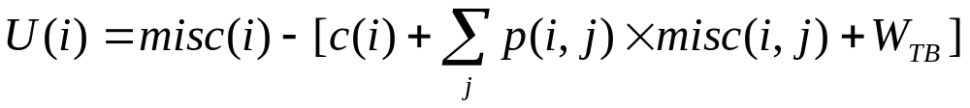
MBT with CSTree
Three components: efficient with the tree
  Initialization: one initial candidate – the first unknown test encountered when a test example is classified by the tree
  Evaluation: select the best from the candidates – use a heuristic utility function to measure the difference of expected total cost before and after test i
    The batch delay cost W_{TB} = max(W_{i})
  Update: update the candidate list – delete the best candidate from L, and add its children into L

Slide 38
Datasets
Using 10 datasets from UCI
 | No. of Attributes | No. of Examples | Class dist. (N/P)
Ecoli | 6 | 332 | 230/102
Breast | 9 | 683 | 444/239
Heart | 8 | 261 | 98/163
Thyroid | 24 | 2000 | 1762/238
Australia | 15 | 653 | 296/357
Tic-tac-toe | 9 | 958 | 332/626
Mushroom | 21 | 8124 | 4208/3916
Kr-vs-kp | 36 | 3196 | 1527/1669
Voting | 16 | 232 | 108/124
Cars | 6 | 446 | 328/118

Slide 39
Experiment Setting
Each dataset is split into training set (60%) and testing set (40%)
Mask the attribute values of testing examples as unknown
Unknown attribute ratios (r=0.2, 0.4, 0.6, 0.8, 1.0)
  For example: r=1.0 (All unknown)
A1 | A2 | A3 | A4 | A5
? | ? | ? | ? | ?
A1 | A2 | A3 | A4 | A5
1 | 2 | 2 | 1 | 1

Slide 40
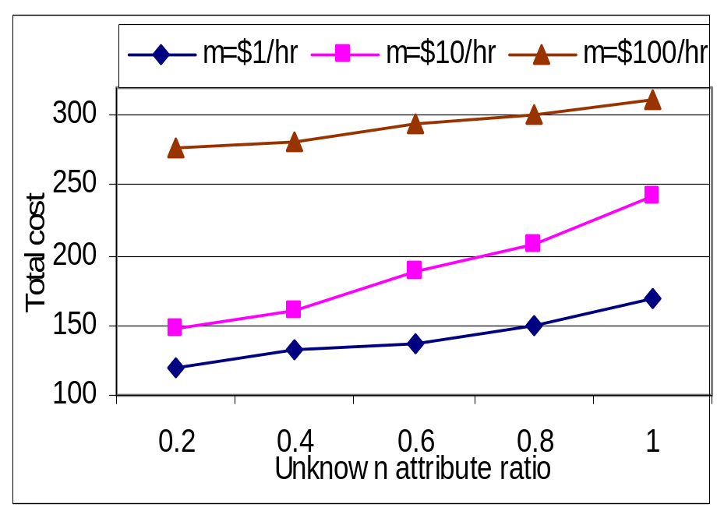
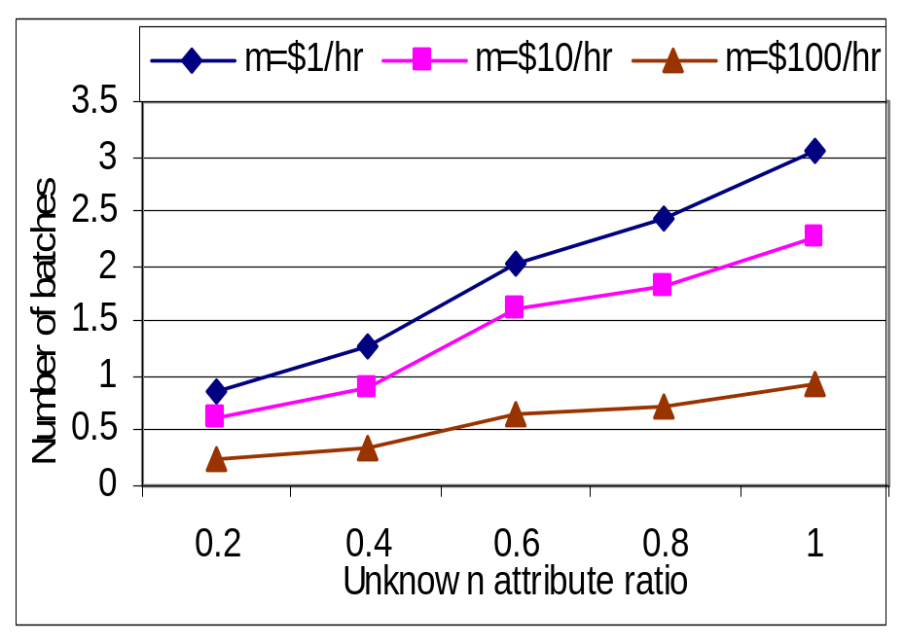
Revisit the Heart Disease Dataset

Slide 41
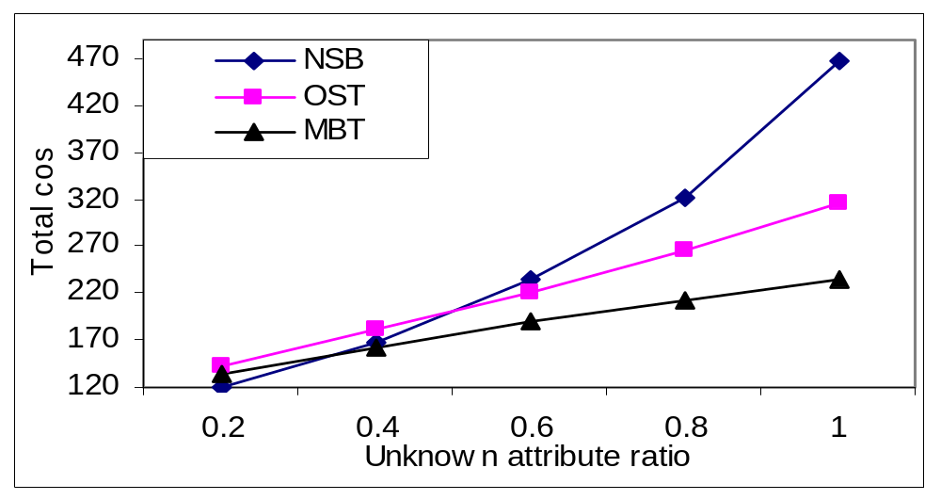
Experimental Comparison
Sequential Test (OST): one test, wait, … then predict
Naïve Single Batch Test (NSB): one batch of tests, then predict

Slide 42
Conclusions
Cost-sensitive decision tree
  Can be used to model learning in the cost environment
Feature value acquisition for diagnosis (test strategies)
  Sequential Test: one test, wait, …: low cost but long wait
  Single Batch Test: one batch of tests: quick but higher cost
  Multiple Batch Test: batch, wait, batch, …: best tradeoff
MBT performs better than the others

